Slide 1

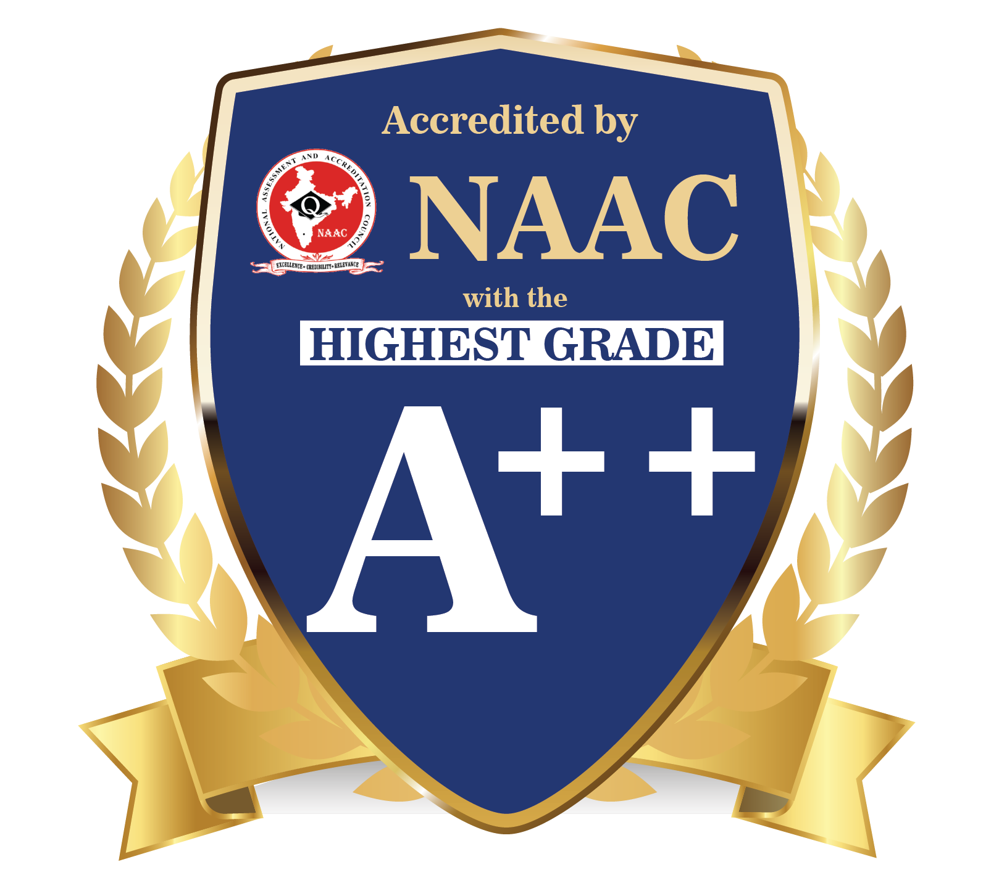

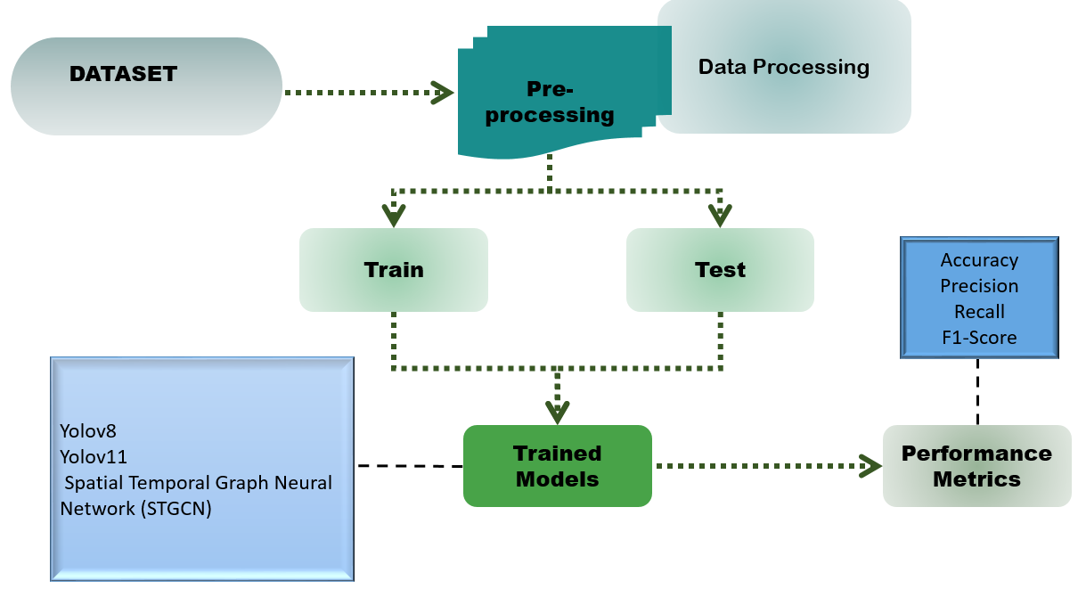
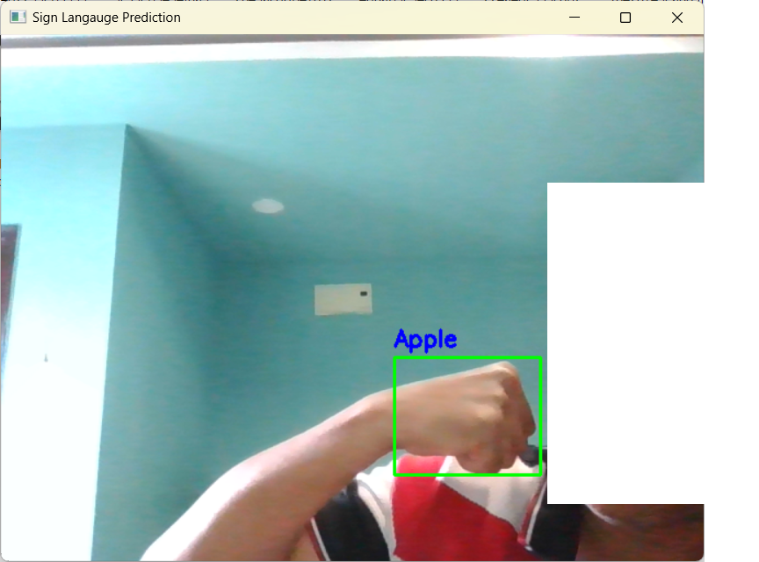
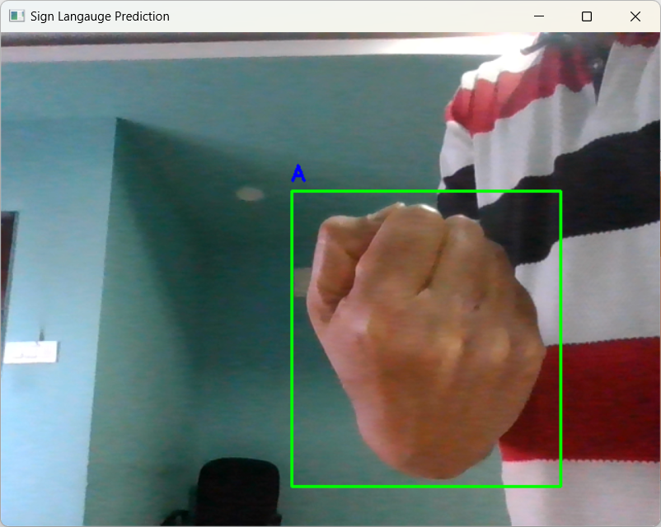
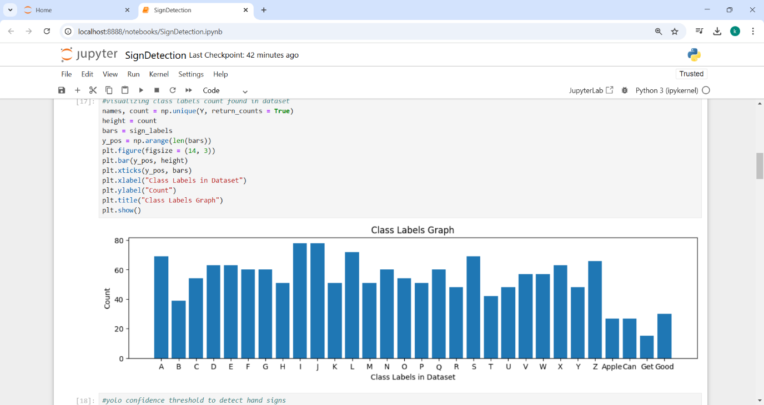
SIGN TALK: GESTURE LANGUAGE TRANSLATOR
A.N.P. Sri Charith¹; I.Harsha Vardhan²; B.Tharun Kumar³; ^{1,2,3} Vel Tech University.
Abstract
Results
Sign language is a vital form of communication for the deaf and hard-of-hearing community. We present a novel system for real-time sign language detection using a standard web camera to bridge the communication gap between sign language users and non-signers. This system aims to recognize sign language gestures performed in front of the camera, subsequently converting them into voice output and displaying the corresponding text on screen. Deep learning techniques are being used in the proposed work to identify and detect hand signs. We are working with a number of algorithms in this area, including Yolov8, Yolov11, and the Spatial Temporal Graph Neural Network (STGCN). YoloV11 has the best Mean Precision result out of all the algorithms, and it can recognize the most test hand signs with an accuracy of above 99%. We used the American Sign Language dataset, which includes the alphabets A through Z as well as words like "Apple," "get," "Good," and "can," to train and evaluate the effectiveness of the aforementioned algorithms.
The system demonstrated exceptional accuracy in recognizing sign language gestures, with YOLOv11 achieving over 99% mean precision, outperforming other models such as YOLOv8 and STGCN. The evaluation was conducted using the American Sign Language dataset, which includes alphabets A to Z along with commonly used words like “Apple,” “Get,” “Good,” and “Can.” This dataset allowed for comprehensive testing, ensuring the system could accurately identify a wide range of hand signs.
One of the standout features of this project is its dual output mechanism, which provides both text and voice translations of detected signs. This ensures better accessibility for individuals who do not understand sign language, allowing seamless communication between signers and non-signers. Additionally, the system was tested for real-time performance, and it successfully recognized and translated signs with minimal latency, making it a viable solution for practical applications.
Beyond its technical performance, this project holds significant potential for real-world implementation in various domains such as education, healthcare, and public services. Integrating sign language recognition into everyday devices with cameras, it can enhance communication accessibility for the deaf and hard-of-hearing community. The success of this model marks a step forward in breaking communication barriers and fostering inclusivity.
Introduction
The project presented here is a groundbreaking endeavor that addresses a significant challenge faced by the deaf and hard-of-hearing community: the communication gap between sign language users and those who are not proficient in sign language.
In this modern age where technology is pivotal in enhancing our lives, a team of innovators has developed a novel system to bridge this gap using readily available tools – a standard web camera.
Sign language is a vital and beautiful form of communication, allowing the deaf and hard of hearing to express themselves, connect with others, and access information.
However, it remains a barrier for those who do not understand it, limiting inclusivity and access to vital services and information.
This project aims to change that by introducing a real-time gesture language translator system. The core of this system lies in cutting-edge computer vision techniques, particularly deep learning models, which enable it to capture and analyze sign language gestures accurately.
Discussion
Our real-time sign language detection system was evaluated using YOLOv8, YOLOv11, and STGCN, with YOLOv11 achieving the highest accuracy of over 99%. The system successfully converts detected gestures into both text and voice output, improving accessibility for non-signers.
A key strength of this approach is its robust performance across different lighting conditions and hand positions. However, challenges remain in detecting complex sentences and overlapping gestures. Future improvements, such as expanding the dataset and integrating contextual understanding, could further enhance its practical applications.
Table 1. Label in 24pt Calibri.
Methods and Materials
The system utilizes computer vision and deep learning techniques to recognize sign language gestures in real-time. A standard web camera captures hand movements, which are then processed using YOLOv8, YOLOv11, and STGCN to detect and classify signs. The American Sign Language dataset, containing alphabets (A-Z) and common words, was used for training and evaluation. Among the tested models, YOLOv11 achieved the highest accuracy with over 99% mean precision. The recognized gestures are converted into text and voice output, ensuring accessibility. The system is optimized for real-time performance with minimal latency, making it practical for real-world applications.
Figure 1. Architecture Diagram.
Figure 2. Apple in sign language.
Figure 3. “A” in sign language
Conclusions
This project represents a significant advancement in sign language recognition technology, offering an innovative real-time solution for bridging the communication gap between sign language users and non-signers. By leveraging deep learning and computer vision, the system provides an accessible and practical tool for enhancing inclusivity. The high accuracy achieved by YOLOv11 underscores its potential for real-world applications. Future developments could focus on expanding the sign vocabulary, integrating multi-language support, and improving contextual understanding to further enhance communication for the deaf and hard-of-hearing community.
Chart 1. Class Labels for all values in dataset .
Acknowledgments
References
A.N.P.Sri Charith, I.Harsha Vardhan, B.Tharun Kumar.
Vtu19917, Vtu20116, Vtu21148.
Dept. AIML; Vel Tech University.
SUPERVISED BY
Ms. Annal Priyadarshini D., M.E.
Mohamed Hisham Jaward, Ming Jin Cheok, Zaid Omar. ”A review of hand gesture and sign language recognition techniques.”. 2023.
Tessa Verhoef, Patrick Boudreault, Oscar Koller. “Sign Language Recognition, Generation, and Translation: An interdisciplinary Perspective.”.2021.
Lionel Pigou, Sander Dieleman, Pieter-Jan Kindermans. “Sign Language Recognition Using Convolutional Neural Network.”.2022.
Starner T, Weaver J, Pentland A (2020) Real-time American sign language recognition using desk and wearable computer based video. IEEE Trans Pattern Anal Mach Intell 20:1371–1375
Lee J, Lee Y, Lee E, Hong S (2022) Hand region extraction and gesture recognition from video stream with complex background through entropy analysis. In: Engineering in Medicine and Biology Society, IJIRMPS230387 Website: www.ijirmps.org Email: editor@ijirmps.org 5 2004. IEMBS’04. 26th annual international conference of the IEEE, IEEE, pp 1513–1516
Srinivasan, R., et al. "Python And Opencv For Sign Language Recognition." 2023 International Conference on Device Intelligence, Computing and Communication Technologies,(DICCT). IEEE, 2023.
Daniels, Steve, Nanik Suciati, and Chastine Fathichah. "Indonesian sign language recognition using yolo method." IOP Conference Series: Materials Science and Engineering. Vol. 1077. No. 1. IOP Publishing, 2021.
Verma, Shivam, et al. "Unlocking Communication: YOLO Sign Language Detection System." 2024 8th International Conference on Computing, Communication, Control and Automation (ICCUBEA). IEEE, 2024.

